Slide 1

Problem:
STEMtastic
Lack of women STEM representation in schools and industry

Slide 2
Goal:
A study companion platform on iOS, Android and Amazon Alexa devices that provides women with the tools to find STEM careers.

Slide 3


Features
Alexa skill that brings tutoring, studying and STEM resources to women in their own home.
Mobile app brings tutoring as a mobile and accessible resource
Provides STEM career information and paths
Builds STEM interest for woman at any age, starting at early education level and even up to college

Slide 4
Technology
STEMtastic is built for Alexa smart devices using Node.JS and AWS Lambda for the back-end, iOS using Swift and on Android with Android SDK.

Slide 5
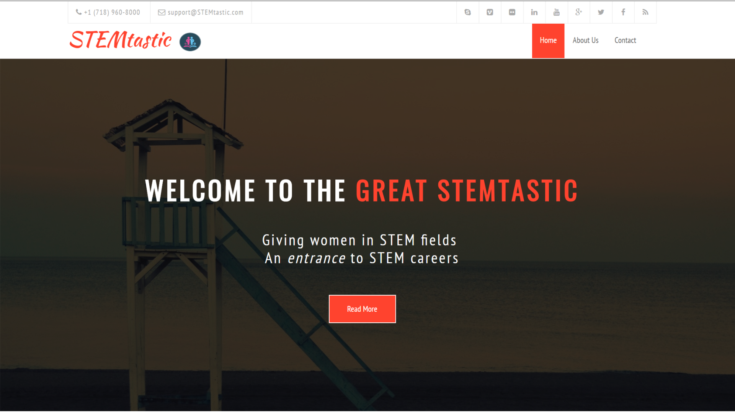

Slide 6
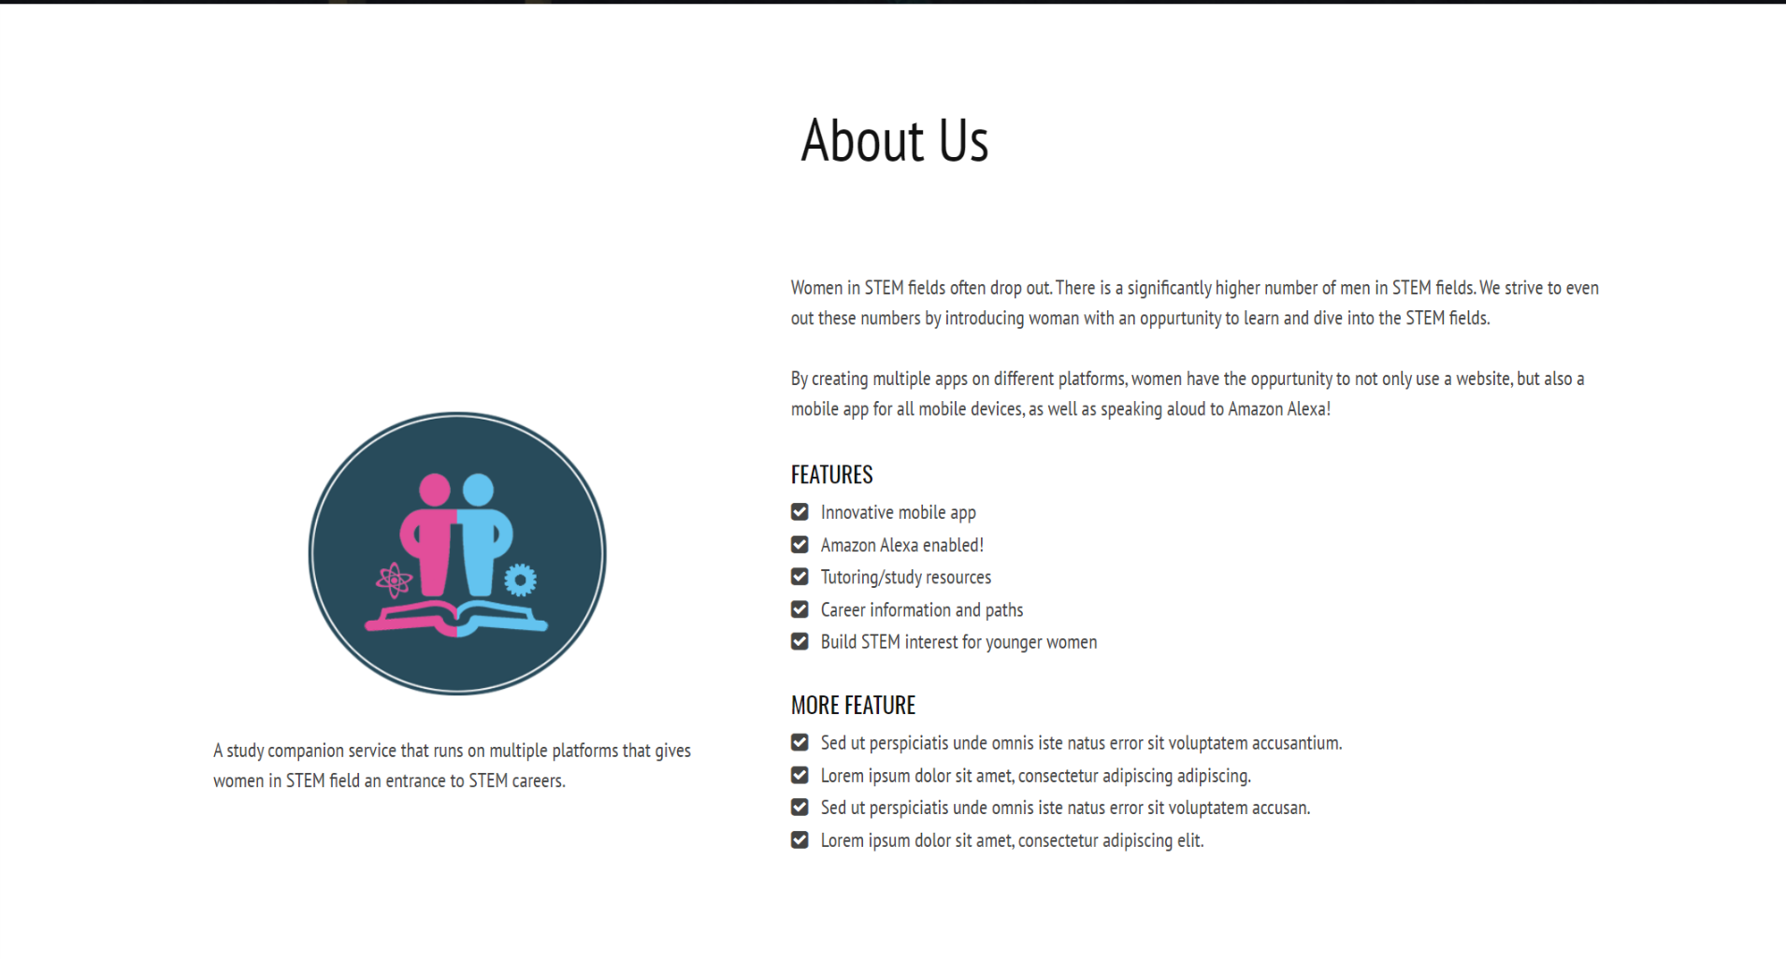

Slide 7

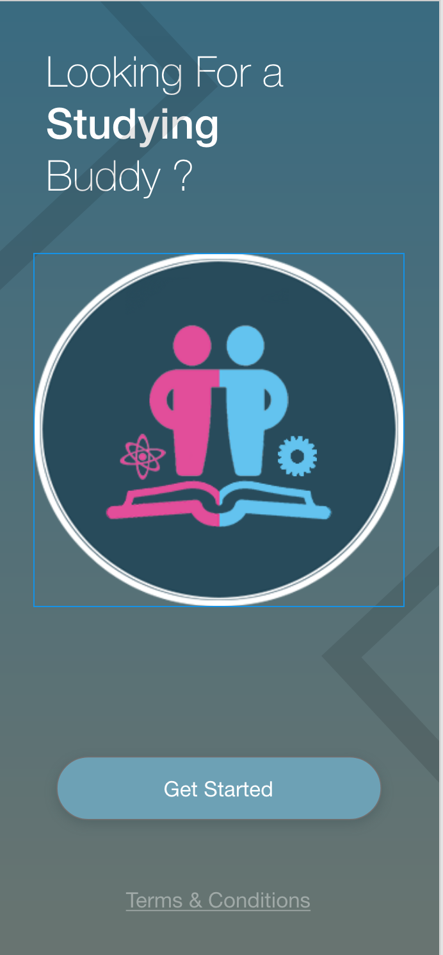
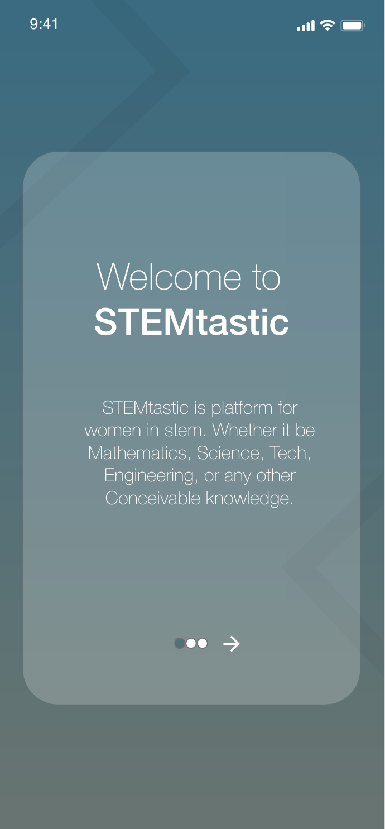
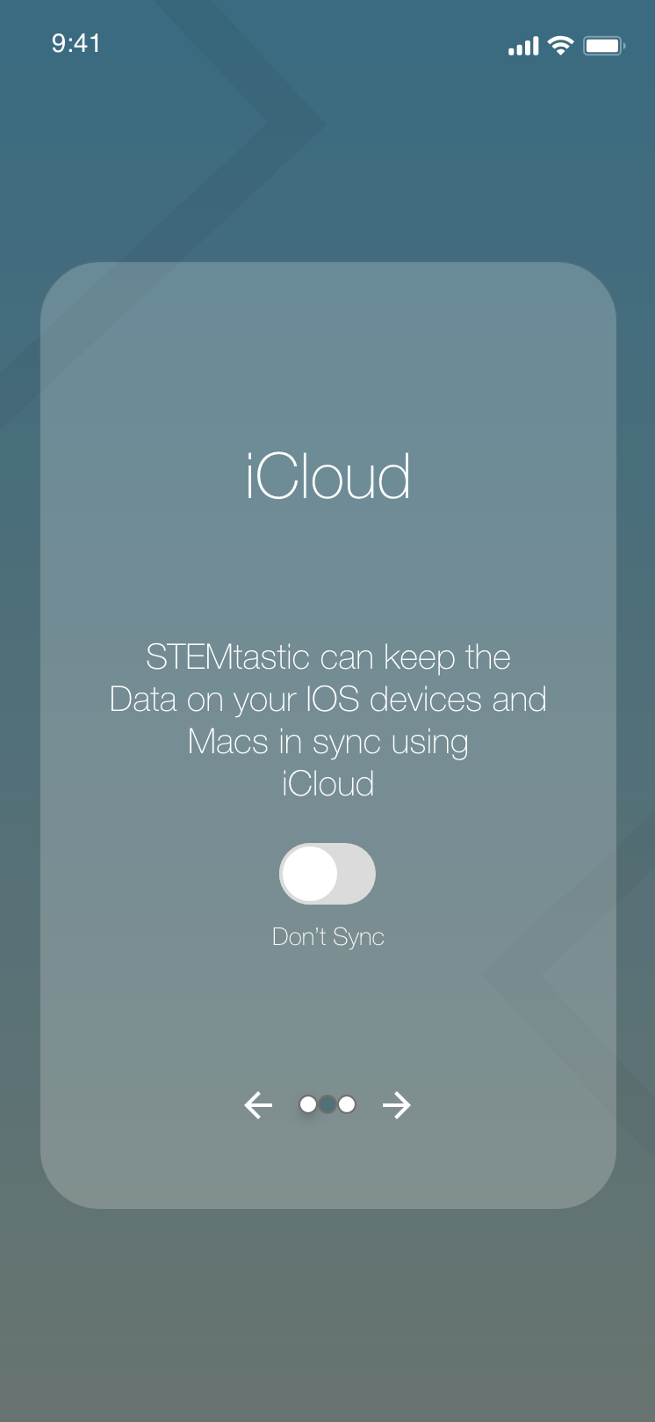
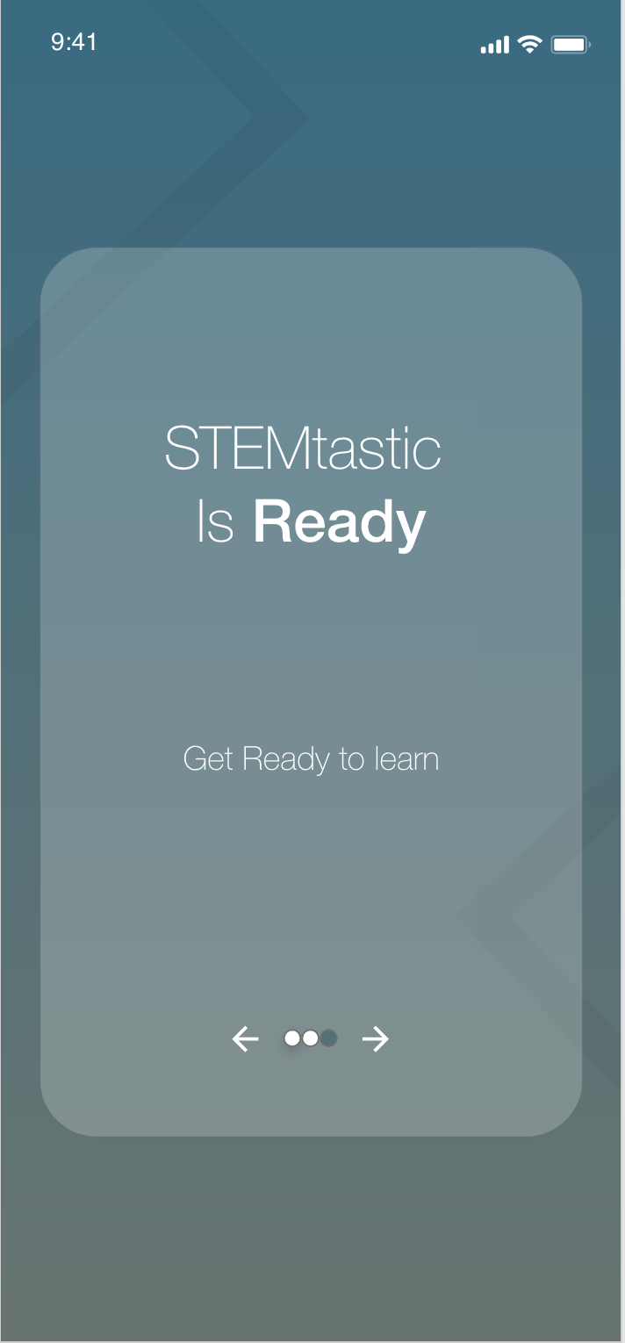

Slide 8
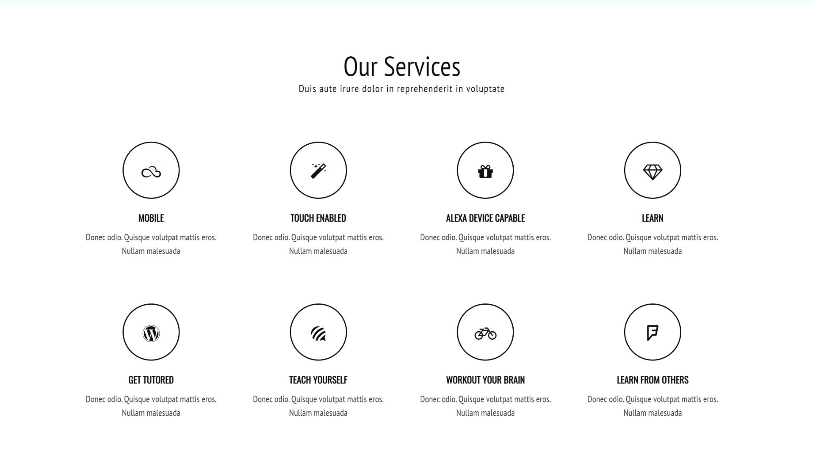

Slide 9
